Slide 1
Lecture 10
Plane Wave Calculation Methods in VASP

Slide 2
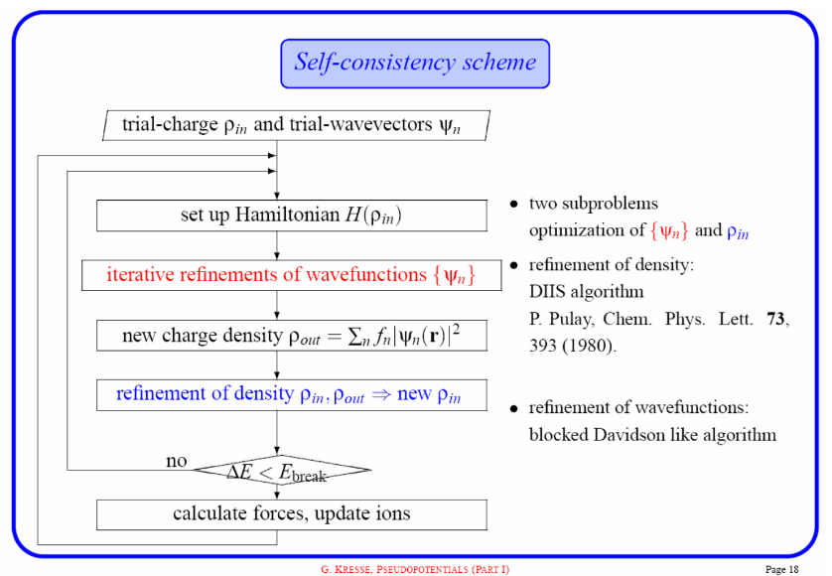
Vasp Input
Need to specify the following for plane wave calculations:
Initial positions of all atoms in system (POSCAR)
Atom identities (POTCAR)
Calculation methods (INCAR)
K-point sampling method (KPOINTS)
Choose INCAR parameters based on the type of calculation you are doing. (SCF, DOS, dielectric properties)

Slide 3
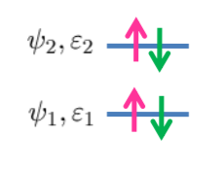
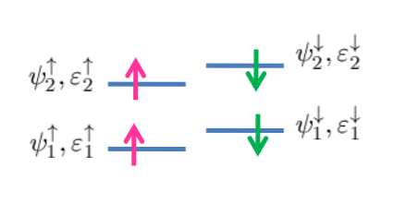
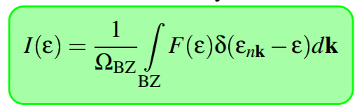
INCAR - Electronic State Treatment
Off (restricted)
On (restricted)
ISPIN - Turn on or off spin polarization
ISMEAR - Methods for solving discontinuous Brillouin Zone integrals. Set 0 for conductors and insulators and 1-5 for metals.
SIGMA - Specifies the width of smearing of the integrand.

Slide 4
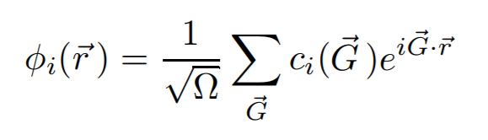
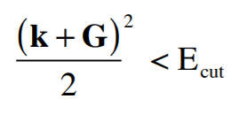
INCAR - Calculation Precision
ENCUT - Controls which plane waves are included in the basis set.
LREAL - Specifies between reciprocal and real space projections for core potentials. Only use real space for systems of > 20 atoms.
PREC - Variations on how ENCUT and LREAL are used in the calculation. Use ‘Accurate’ for high precision and ‘Normal’ for most calculations (faster).

Slide 5
INCAR - SCF Parameters
IALGO - Algorithm used to refine the wavefunction orbitals. Both charge density and orbitals are solved in VASP.
Most common options:
-Conjugate gradient: Safest method generally.
-Blocked Davidson: Moderately stable but not as fast as DIIS.
-RMM-DIIS: Reduces number of orthonormalization steps and is faster than CG or BD.
EDIFF - Specifies SCF convergence. Use 1e-4 or 1e-5.

Slide 6
INCAR - Exchange Correlation
GGA - Specify the DFT XC functional (PBE, PW91, rPBE)
LHFCALC - Provides hybrid functionals that are very computationally expensive but in some cases more accurate. (B3LYP, PBE0, HSE)

Slide 7
Vasp Output
Primarily interested in:
Total energy - OUTCAR
Charge density - CHGCAR shows ρ(x,y,z)
Orbitals - WAVECAR shows details about the final converged wavefunctions. LORBIT controls the DOSCAR output.

